Slide 1
Information Retrieval
Dr. Maheswari Karthikeyan

Slide 2
Lecture Outline
Tolerant Retrieval
Spelling Correction
Phonetic Correction

Slide 3
Spelling correction
Among the various alternative correct spellings for a mis-spelled query, choose the “nearest” one.
When two correctly spelled queries are tied (or nearly tied), select the one that is more common.
Two forms of Correction:
Isolated word
Check each word on its own for misspelling
Will not catch typos resulting in correctly spelled words
e.g., from → form
Context-sensitive
Look at surrounding words,
e.g., I flew form Heathrow to Narita

Slide 4
Isolated word correction
Sec. 3.3.2
Fundamental premise – there is a lexicon from which the correct spellings come
Two basic choices for this
A standard lexicon such as
Webster’s English Dictionary
An “industry-specific” lexicon–hand-maintained
The lexicon of the indexed corpus
E.g., all words on the web
All names, acronyms etc.(Including the mis-spellings)

Slide 5
Isolated word correction
Sec. 3.3.2
Given a lexicon and a character sequence Q, return the words in the lexicon closest to Q
The two techniques are:
Edit distance
k-gram index

Slide 6
Edit distance
Sec. 3.3.3
Given two strings S₁ and S₂, the minimum number of operations to convert one to the other
Operations are typically character-level
Insert, Delete, Replace, (Transposition)
E.g., the edit distance from dof to dog is 1
From cat to act is 2 (Just 1 with transpose.)
from cat to dog is 3.
Edit distance is sometimes known as Levenshtein distance
Dynamic programming technique is used for computing the edit distance

Slide 7
Using edit distances
Sec. 3.3.4
Given query, first enumerate all character sequences within a preset (weighted) edit distance (e.g., 2)
Intersect this set with list of “correct” words
Show the terms found to user as suggestions
Alternatively,
We can look up all possible corrections in our inverted index and return all docs … slow
We can run with a single most likely correction
The alternatives disempower the user, but save a round of interaction with the user

Slide 8
Sec. 3.3.4
Using edit distances
Given a (mis-spelled) query – do we compute its edit distance to every dictionary term?
Expensive and slow
Alternative?
How do we cut the set of candidate dictionary terms?
One possibility is to use k-gram overlap for this
This can also be used by itself for spelling correction.

Slide 9
Levenshtein Distance: Algorithm
The algorithm fills the entries in a matrix m whose two dimensions equals the length of the two strings whose edit distances are being computed
The (i, j) entry of the matrix will hold the edit distance between the strings consisting of the first i characters of s1 and the first j characters of s2.

Slide 10
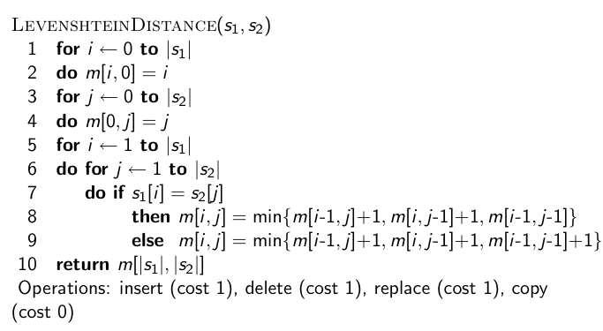
Levenshtein Distance: Algorithm
10

Slide 11
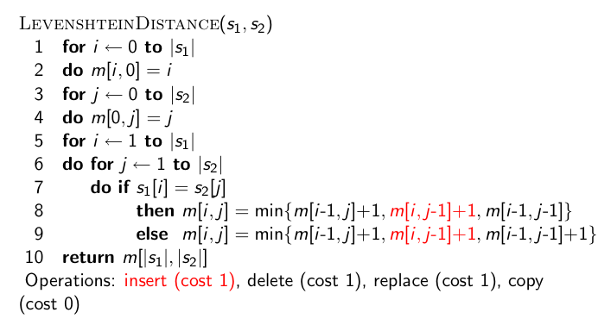
Levenshtein Distance: Algorithm
11

Slide 12
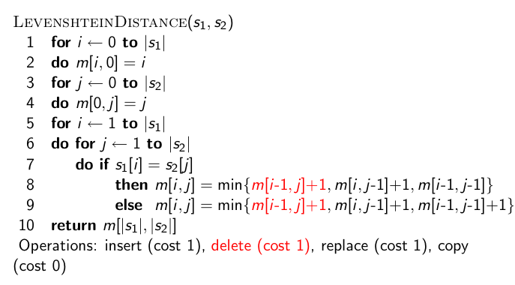
Levenshtein Distance: Algorithm
12

Slide 13
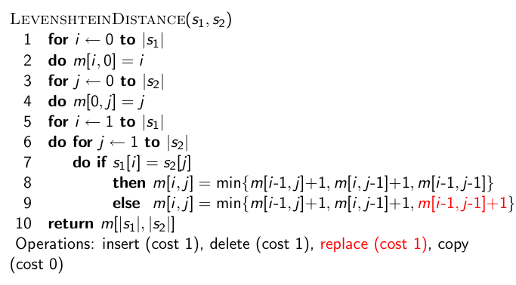
Levenshtein Distance: Algorithm
13

Slide 14
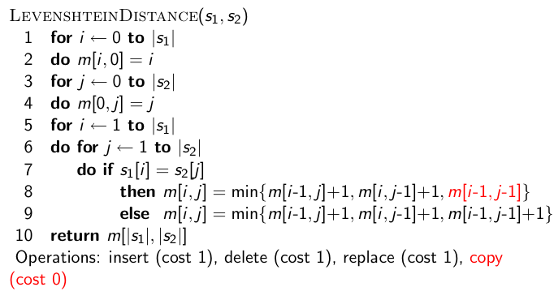
Levenshtein Distance: Algorithm
14

Slide 15
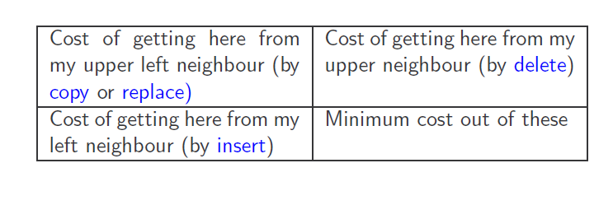
Each cell of Levenshtein matrix
15

Slide 16
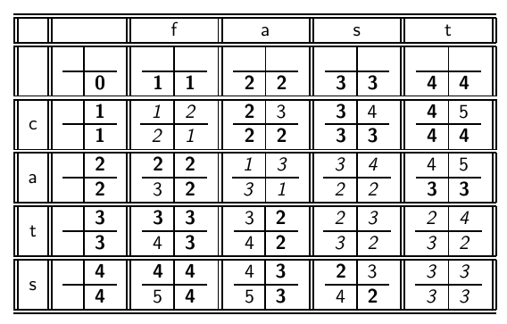
Levenshtein Distance: Example
16

Slide 17
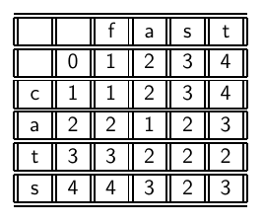
Levenshtein Distance: Example
17

Slide 18
Thank You!

